Slide 1
Alpha Zero in Chess (Sam Johnson)
What:
Pit Alpha Zero against other top chess engines.
Leela Zero is the open source version of Alpha Zero for chess.
Other top engines include Komodo, Shredder, Stockfish 15, Rybka, and Xiphos.
Each engine has 10 seconds per move.
Why:
To see how effective reinforcement learning is against other chess algorithms.
This could help top chess players to improve.

Slide 2
How Alpha Zero Works
Traditional Chess Engine:
They are created by expert chess players.
They have a handcrafted evaluation function.
Depth first search of moves with pruning.
Were able to beat top chess players.
Alpha Zero:
Self-learning instead of handcrafted evaluation function.
v(s) is the win probability of a player from position s.
p(s) is a vector of the value of each legal move from state s.
Use the first neural network to self-play games, which will then train a new neural network.
Use MCTS to evaluate different positions.
Pit old network against new network and see who wins.
Revolutionized modern chess engines.

Slide 3
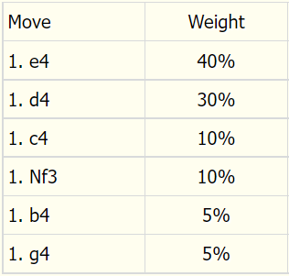
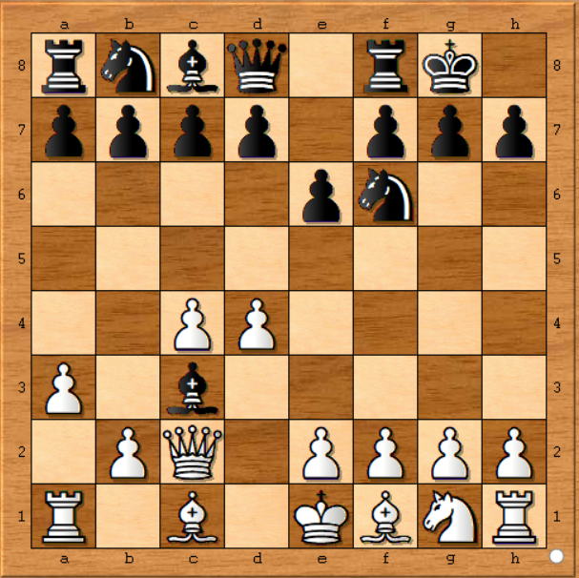
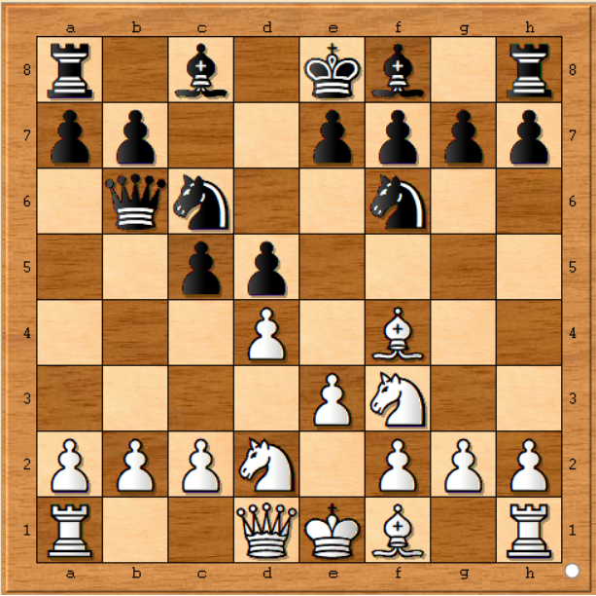
How?
Initial Starting Position:
We use unique starting positions to alleviate deterministic playing behavior.
Tools Used:
Each of the engines was downloaded from its corresponding website.
Python was used for all of the coding.
Matplotlib was using for the coding.
The python-chess library was used to play games.

Slide 4
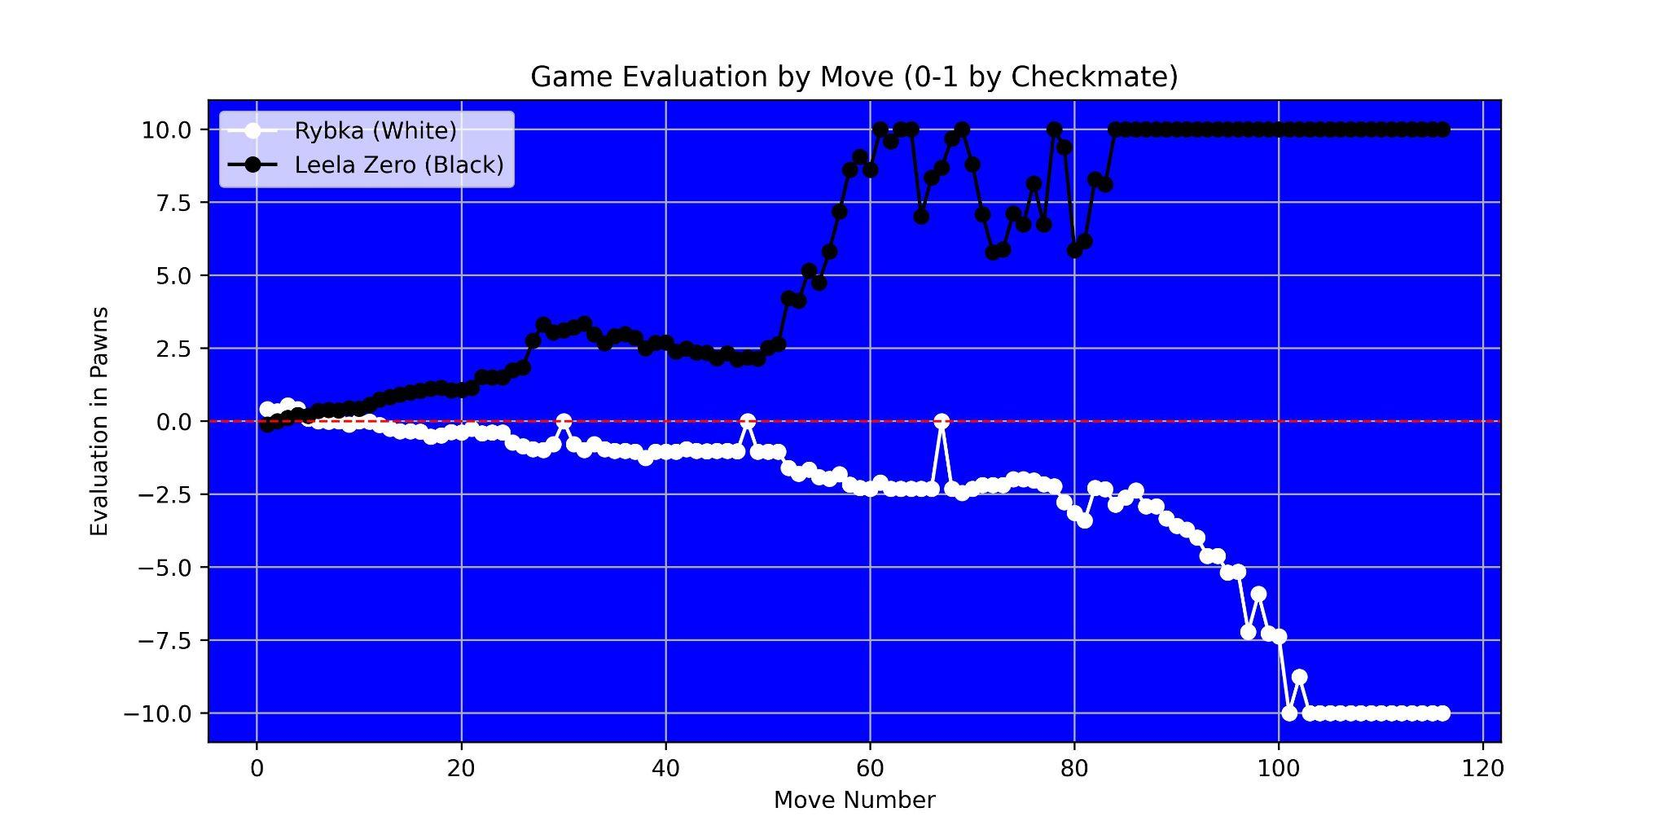
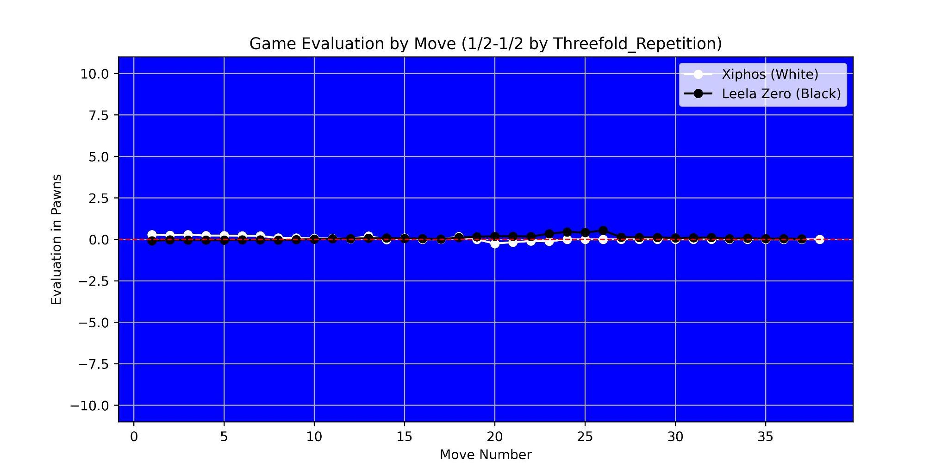
Evaluations
Chess engines return their perceived evaluation at each position.
These evaluations are tracked over time for both players.
Leela Zero wins the first game and draws the second.

Slide 5
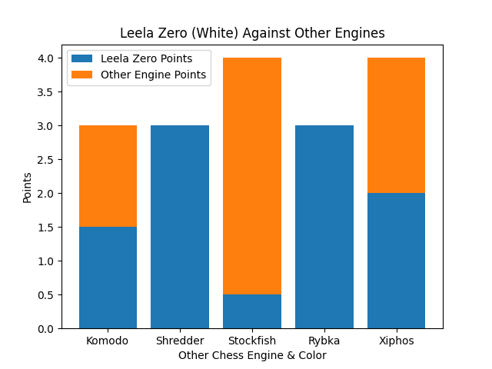
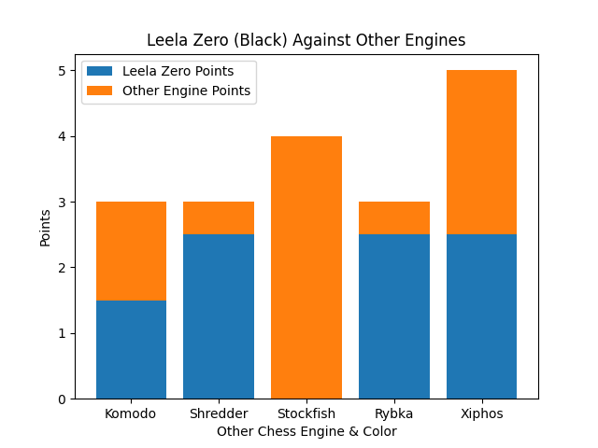
Results
In chess, a win is worth one point, a draw half a point, and a loss zero points.
The results are similar in both plots. Leela Zero tied Komodo & Xiphos, defeated Shredder & Rybka, and lost to Stockfish.
The conclusion is that Alpha Zero (Leela Zero) performed quite well, showing the potential of reinforcement learning.
Future work: Allow GPU use or longer games.

